Slide 1
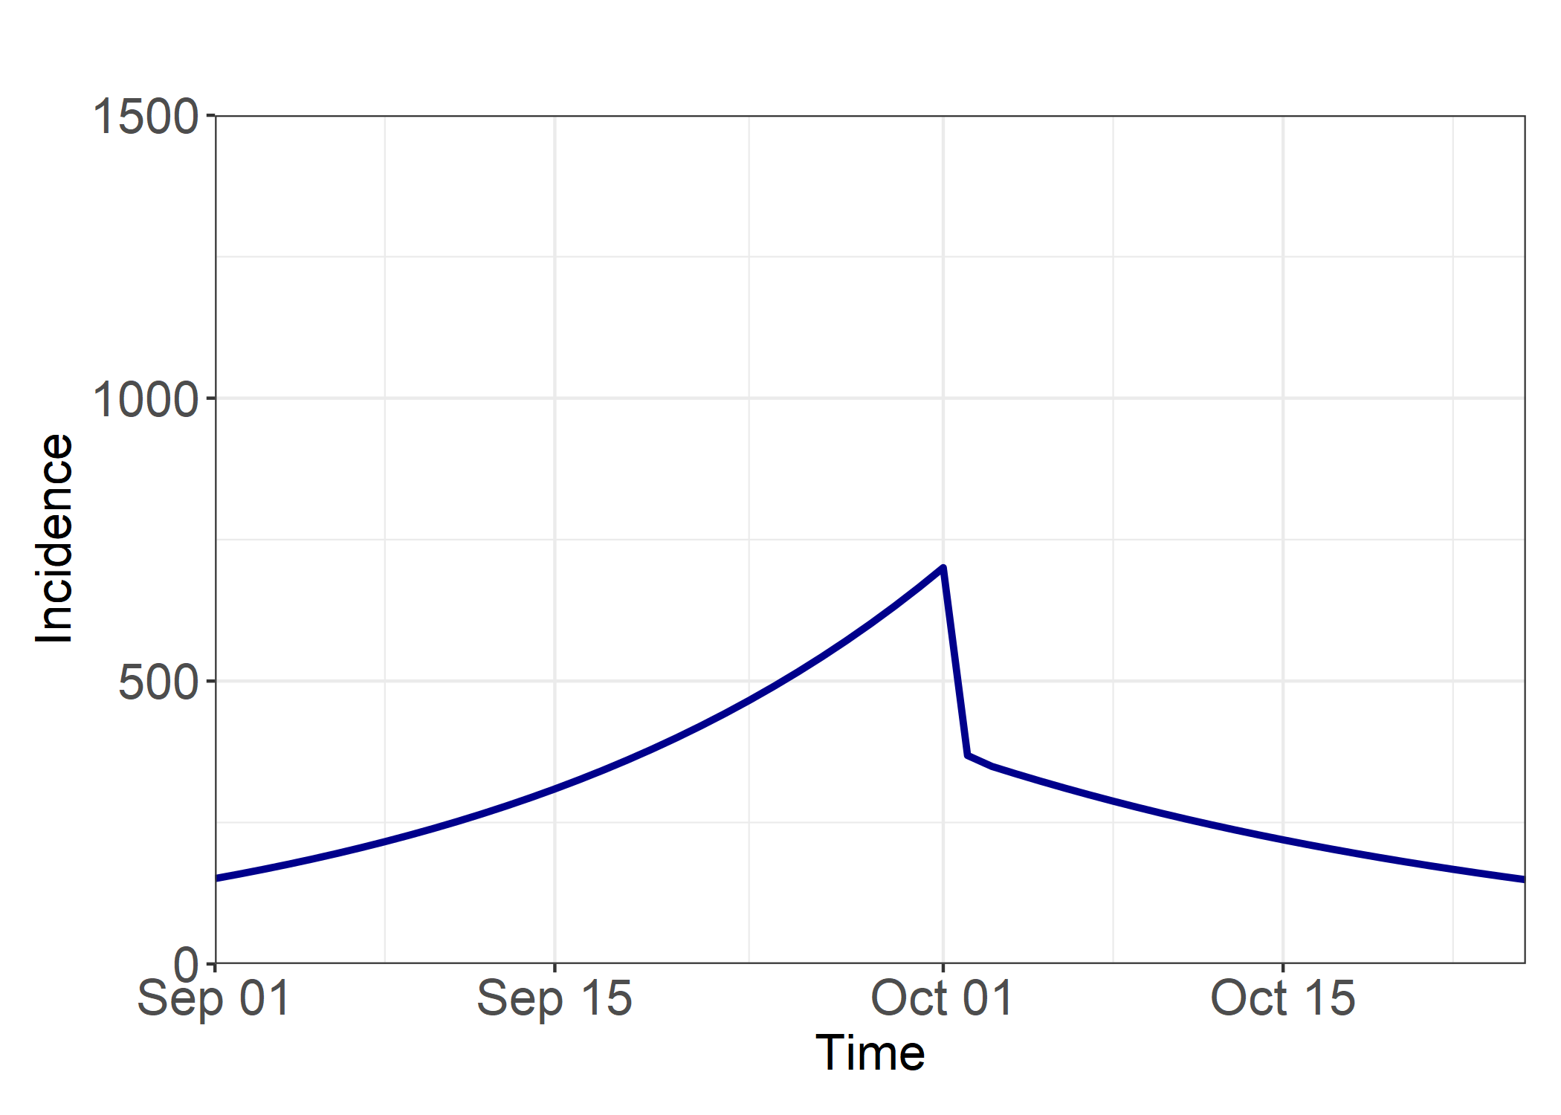
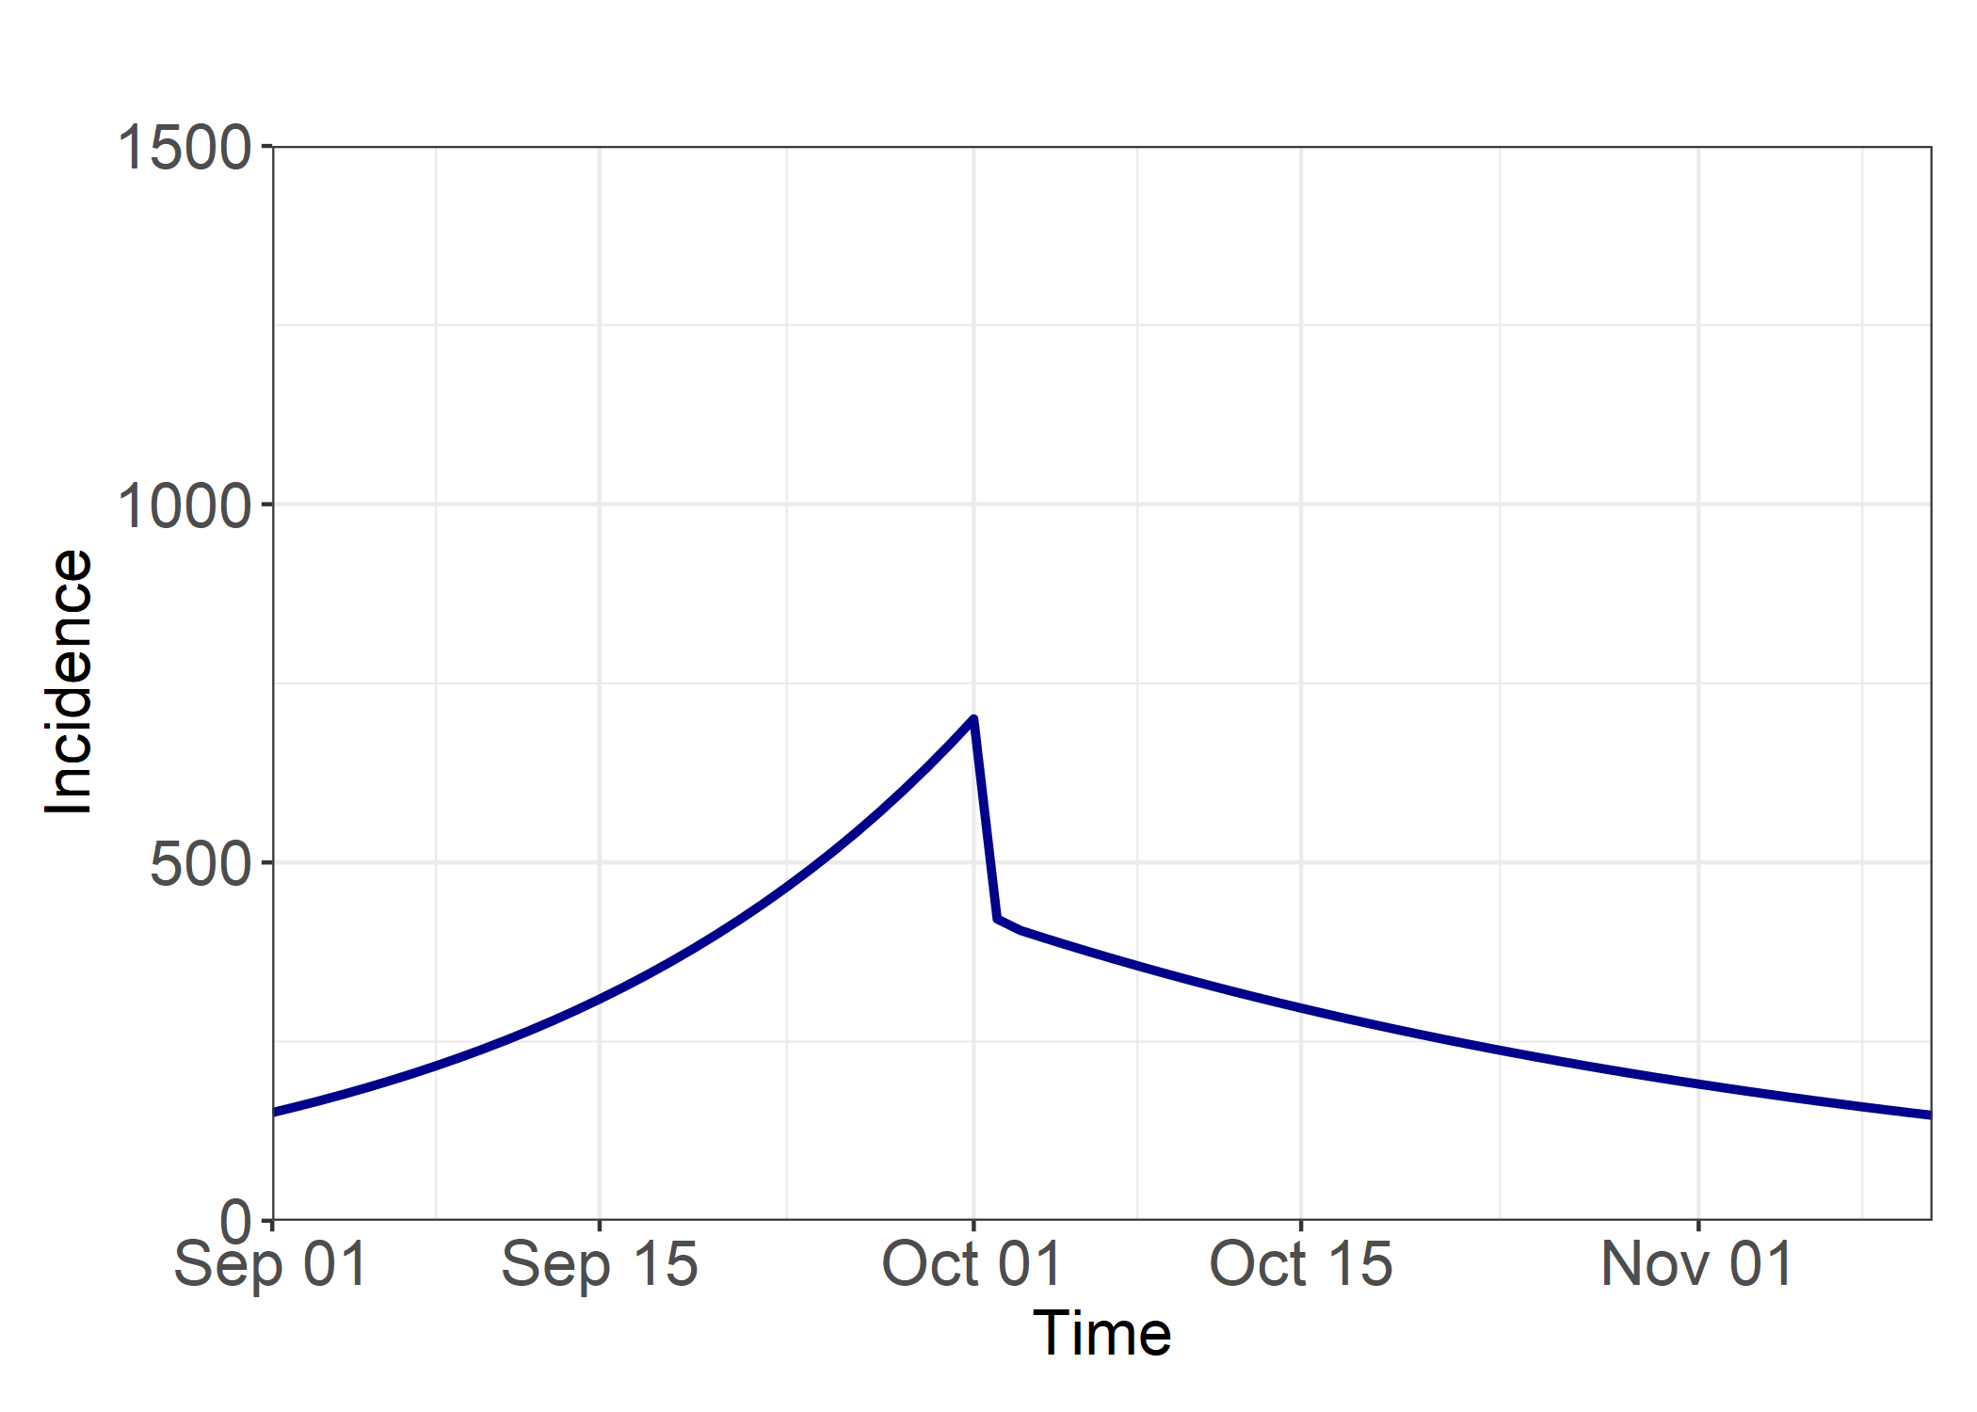
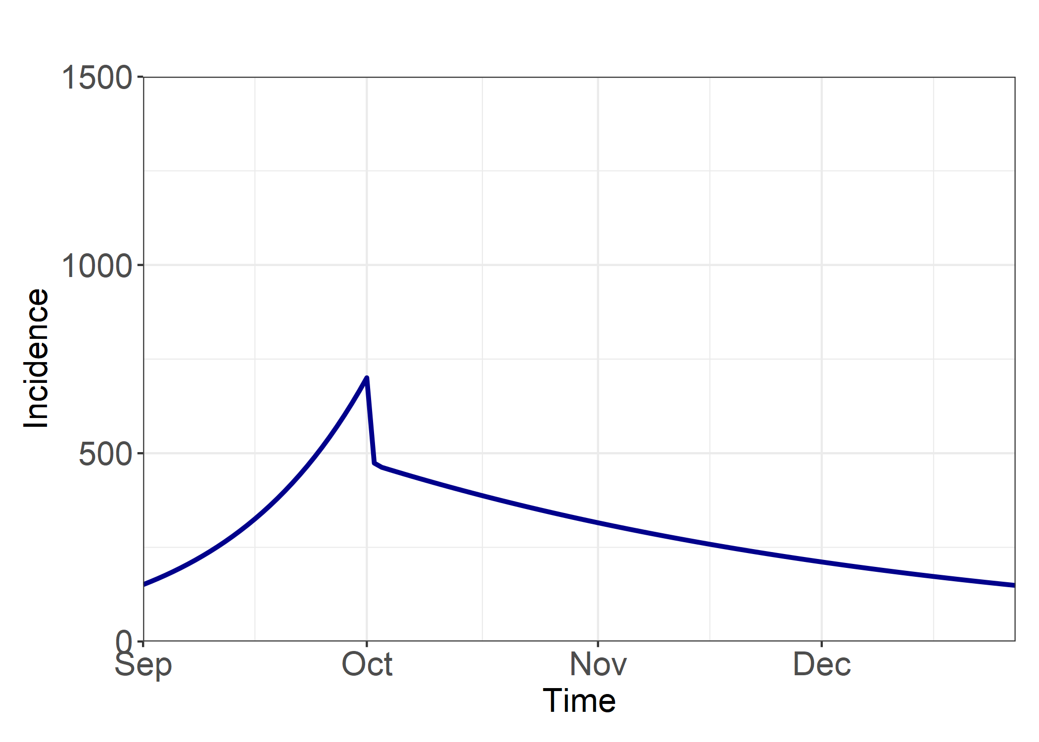
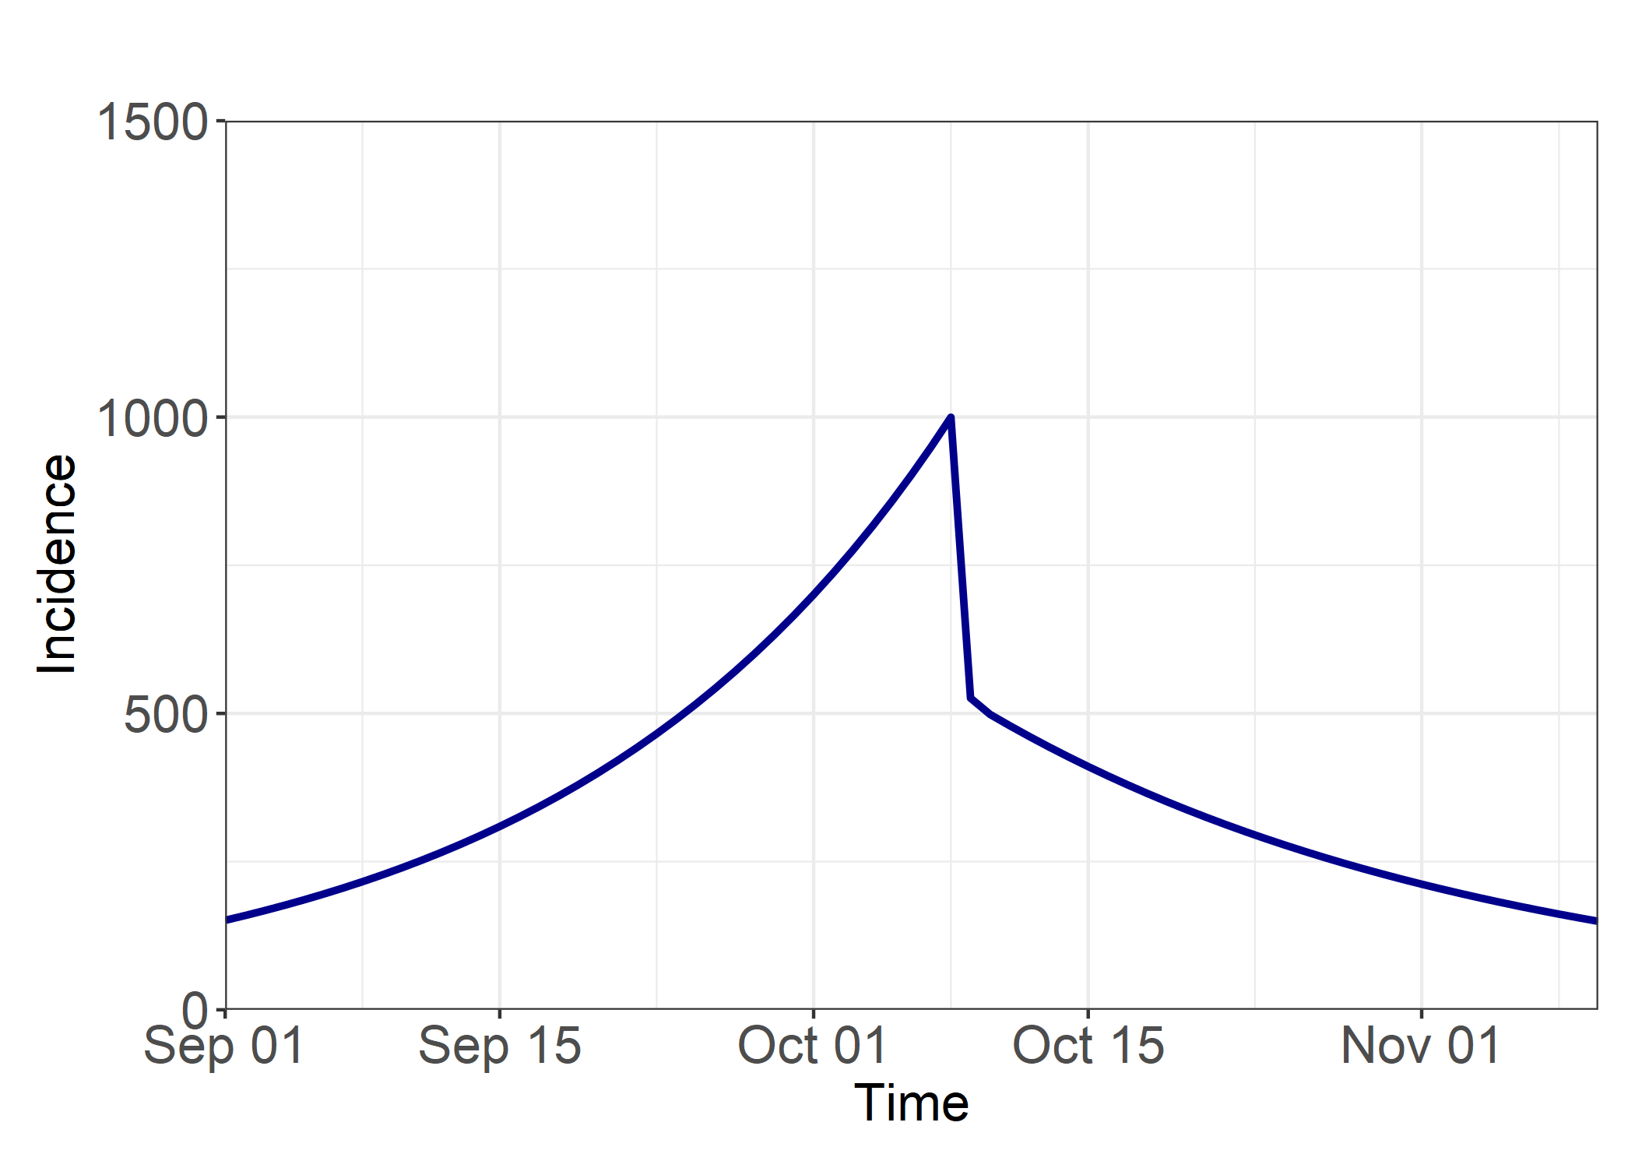
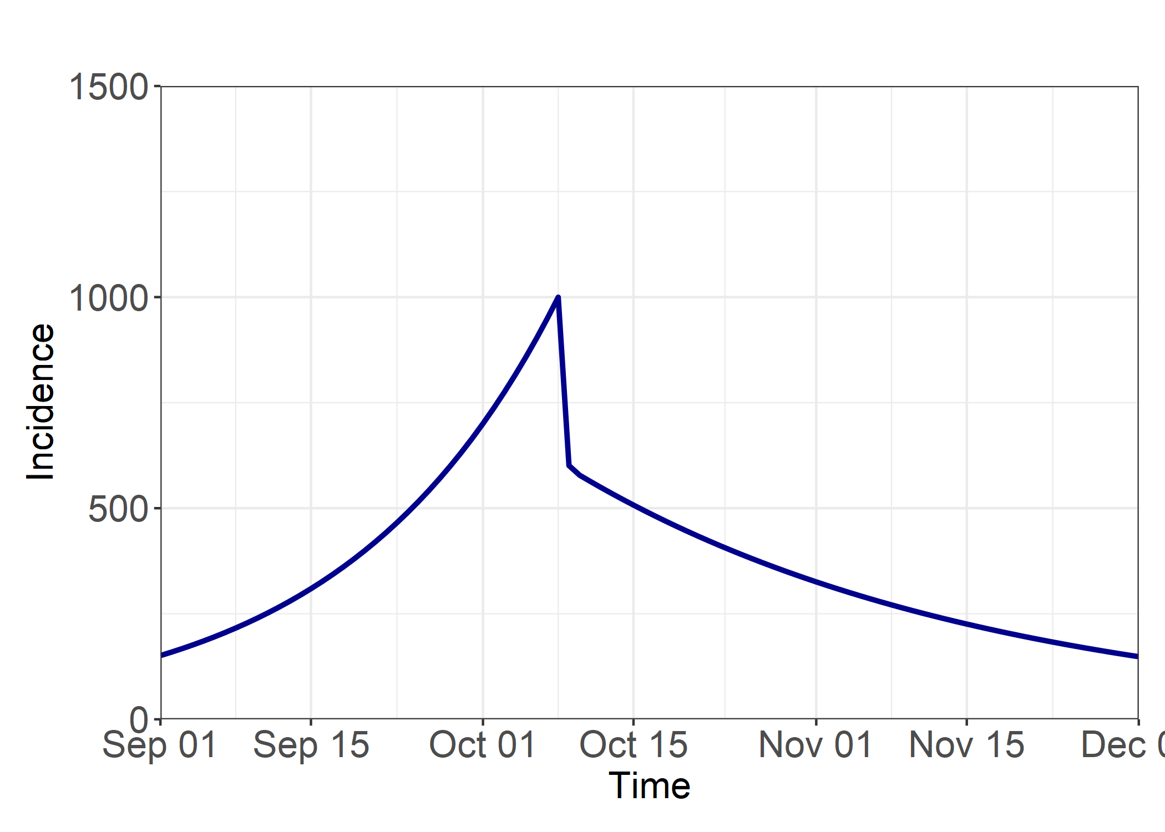
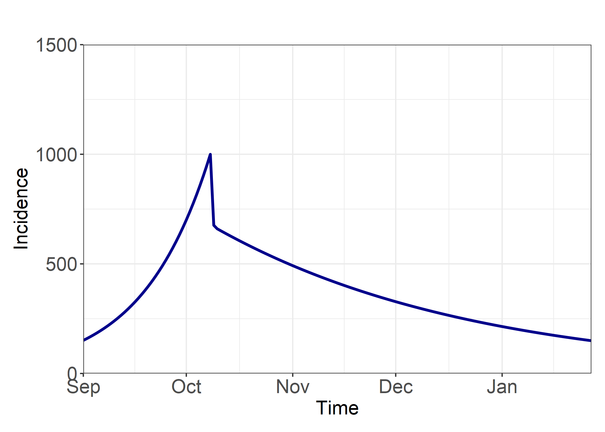
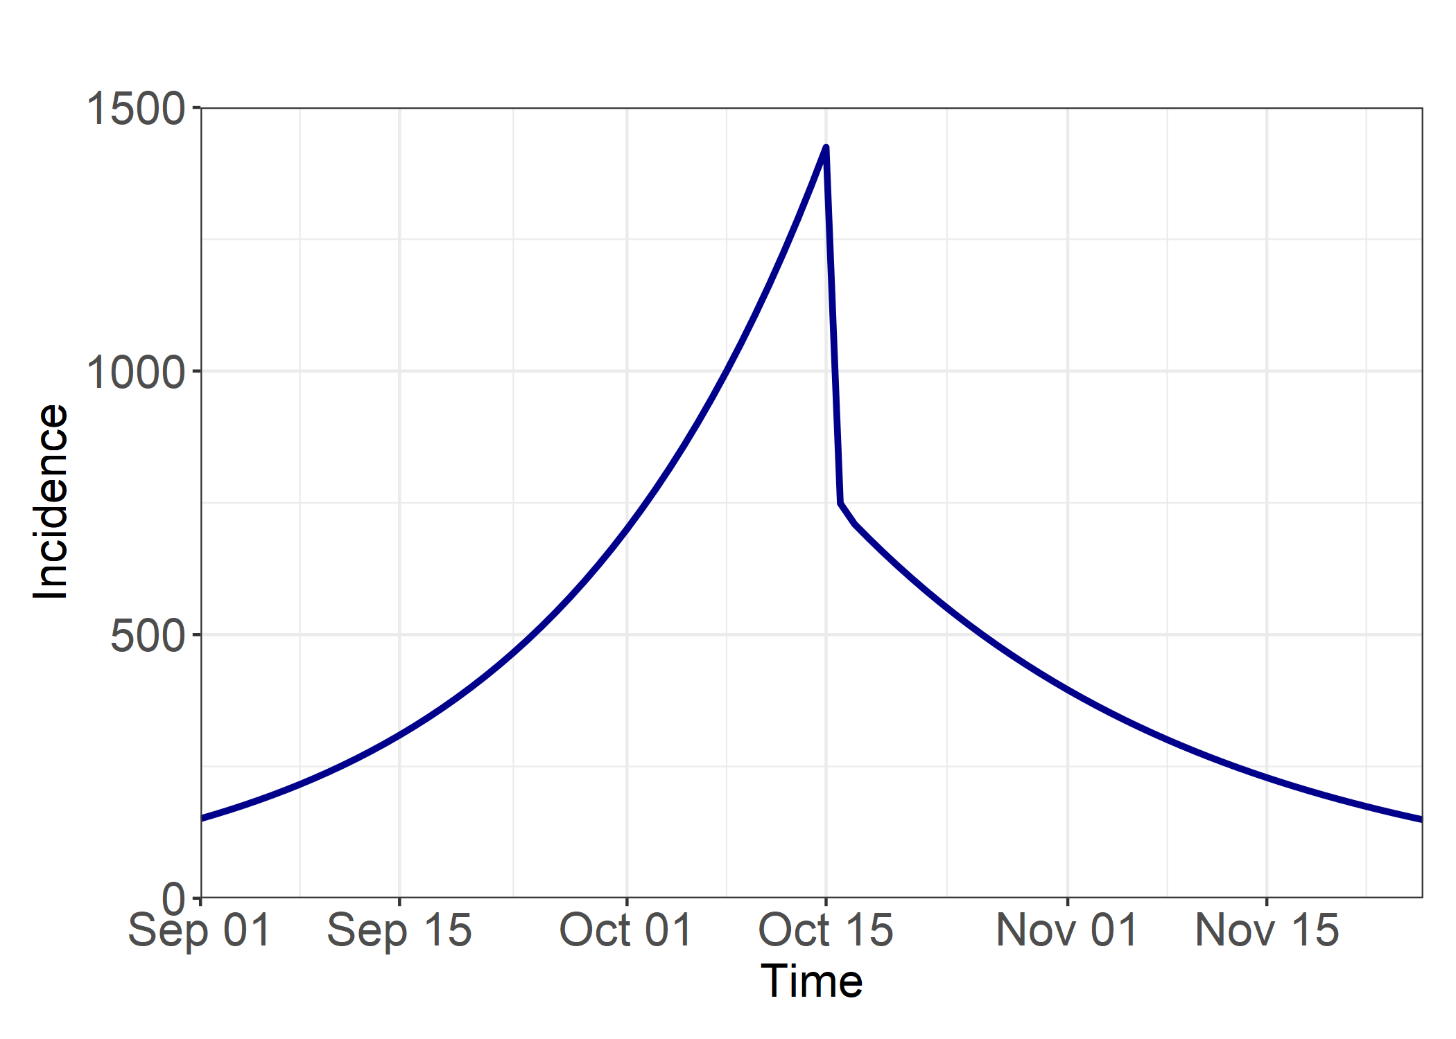
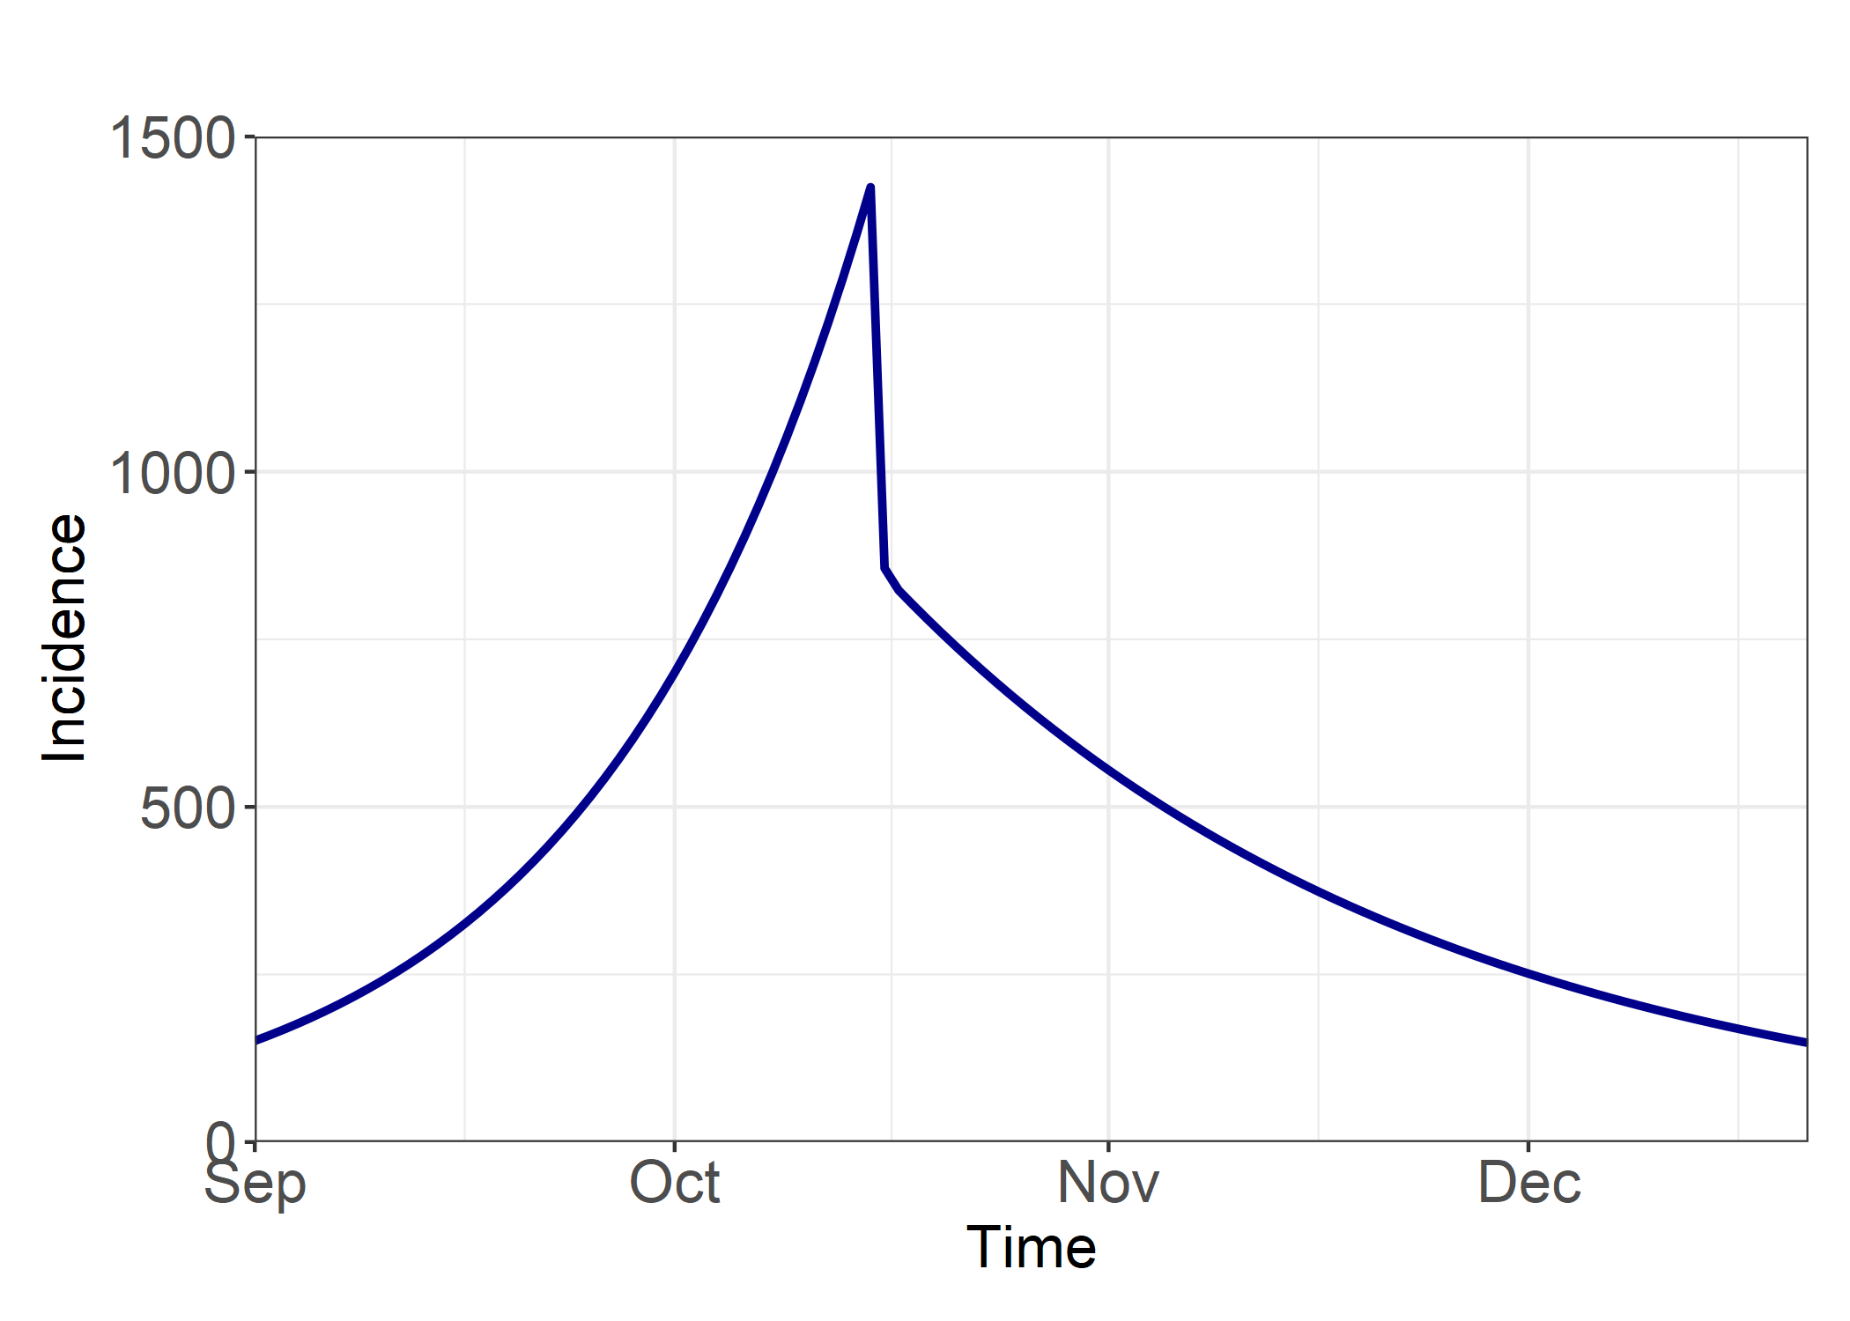
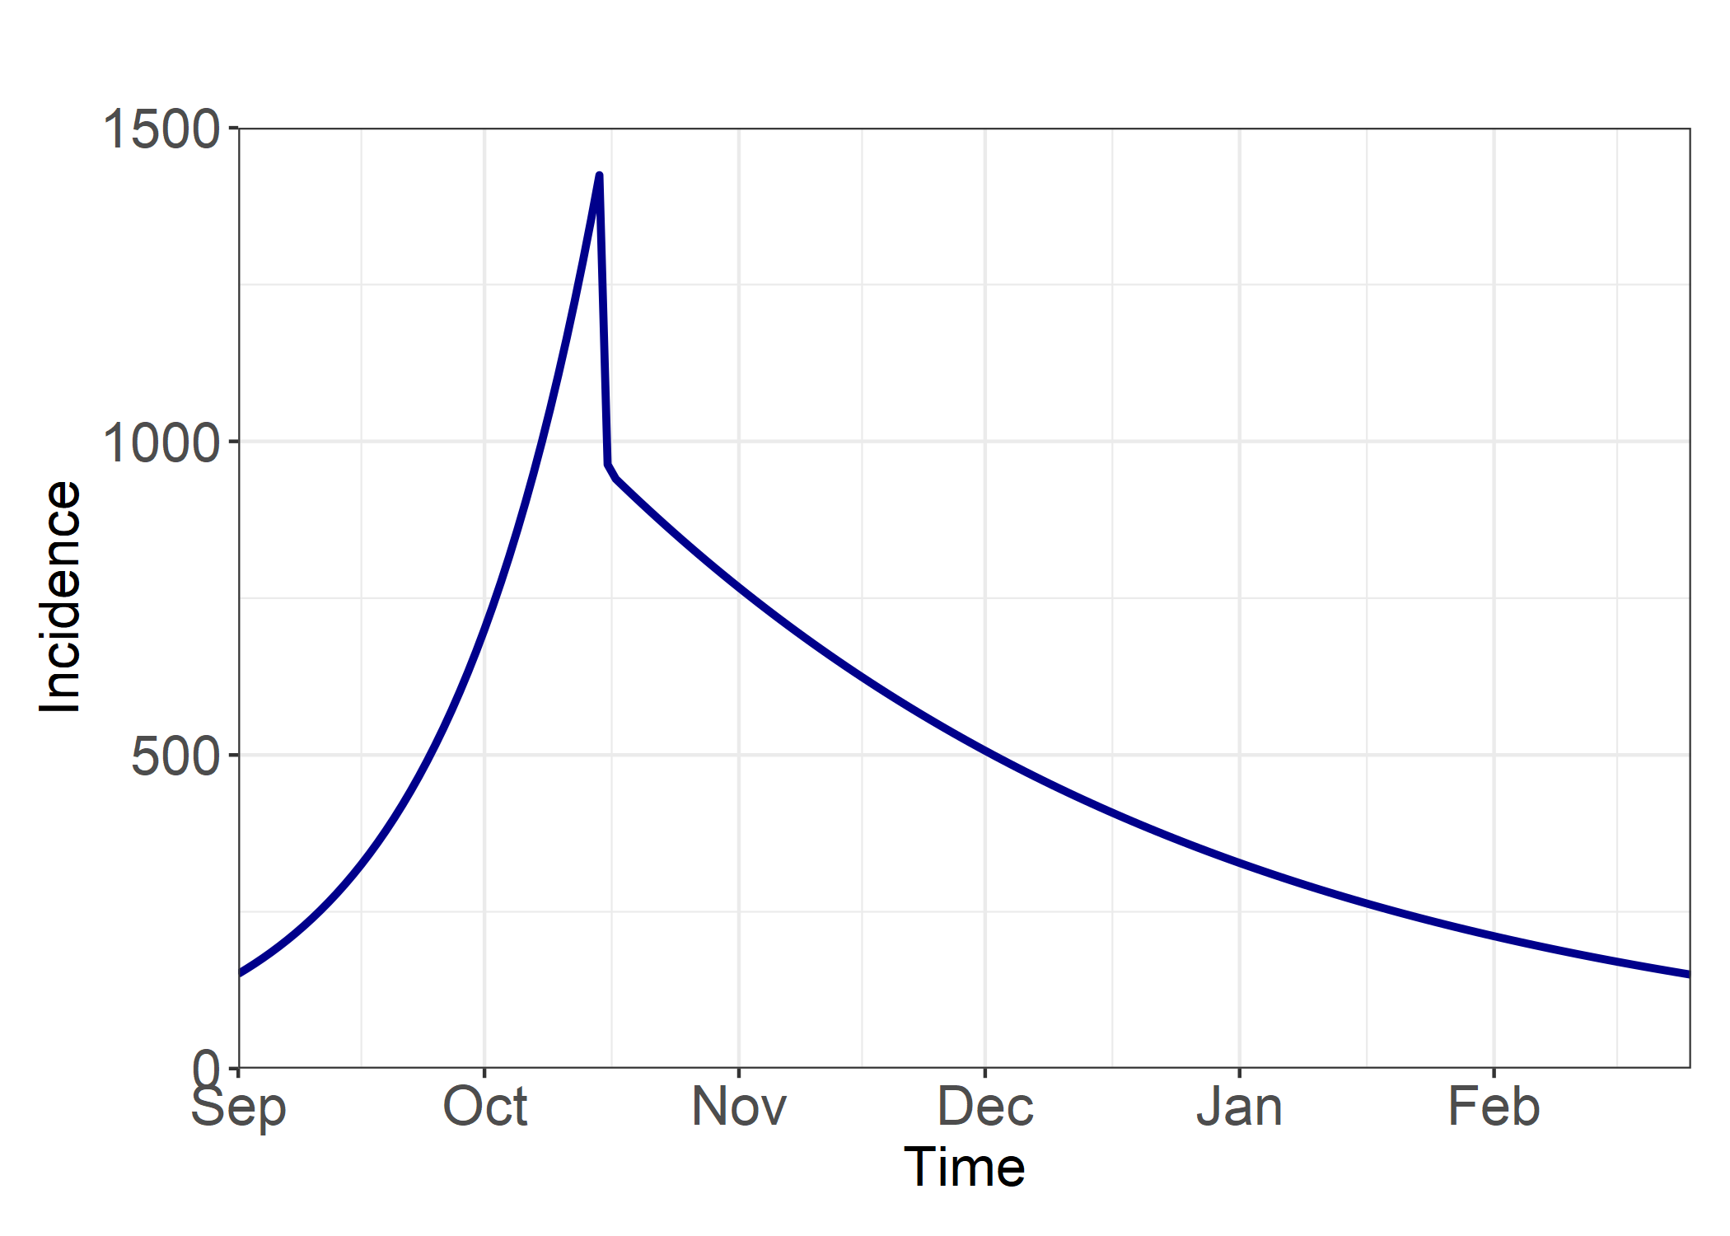
Post Intervention R = 0.7
Post Intervention R = 0.8
Post Intervention R = 0.9
Intervention Delay = 0 Days
A) Total Infections from 01/09/20 = 16932
B) Total Infections from 01/10/20 = 6183
B/A = 0.37
A) Total Infections from 01/09/20 = 21758
B) Total Infections from 01/10/20 = 11009
B/A = 0.51
A) Total Infections from 01/09/20 = 35467
B) Total Infections from 01/10/20 = 24717
B/A = 0.70
Intervention Delay = 7 Days
A) Total Infections from 01/09/20 = 27045
B) Total Infections from 01/10/20 = 16312
B/A = 0.60
A) Total Infections from 01/09/20 = 34610
B) Total Infections from 01/10/20 = 23861
B/A = 0.69
A) Total Infections from 01/09/20 = 55930
B) Total Infections from 01/10/20 = 45180
B/A = 0.81
Intervention Delay = 14 Days
A) Total Infections from 01/09/20 = 41460
B) Total Infections from 01/10/20 = 30711
B/A = 0.74
A) Total Infections from 01/09/20 = 52830
B) Total Infections from 01/10/20 = 42081
B/A = 0.80
A) Total Infections from 01/09/20 = 84213
B) Total Infections from 01/10/20 = 73463
B/A = 0.87

Slide 2
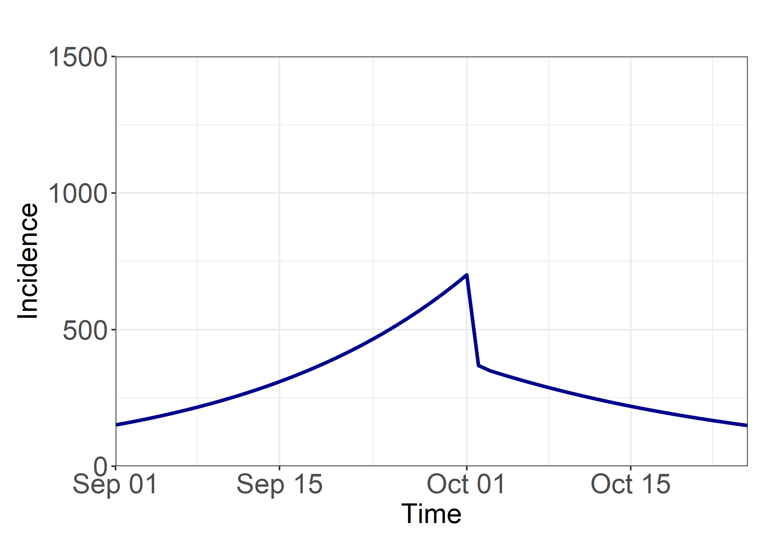
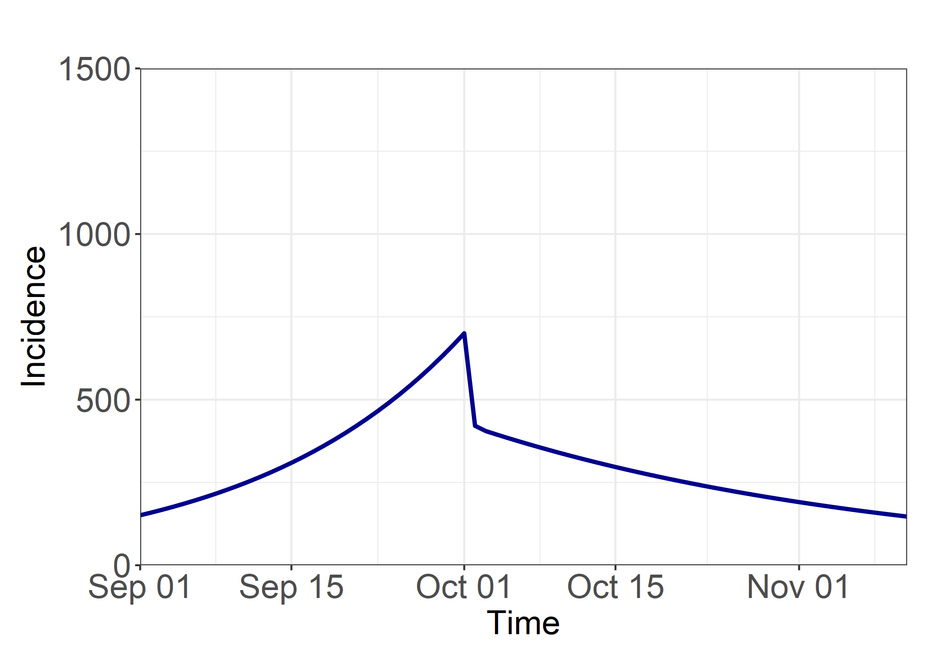
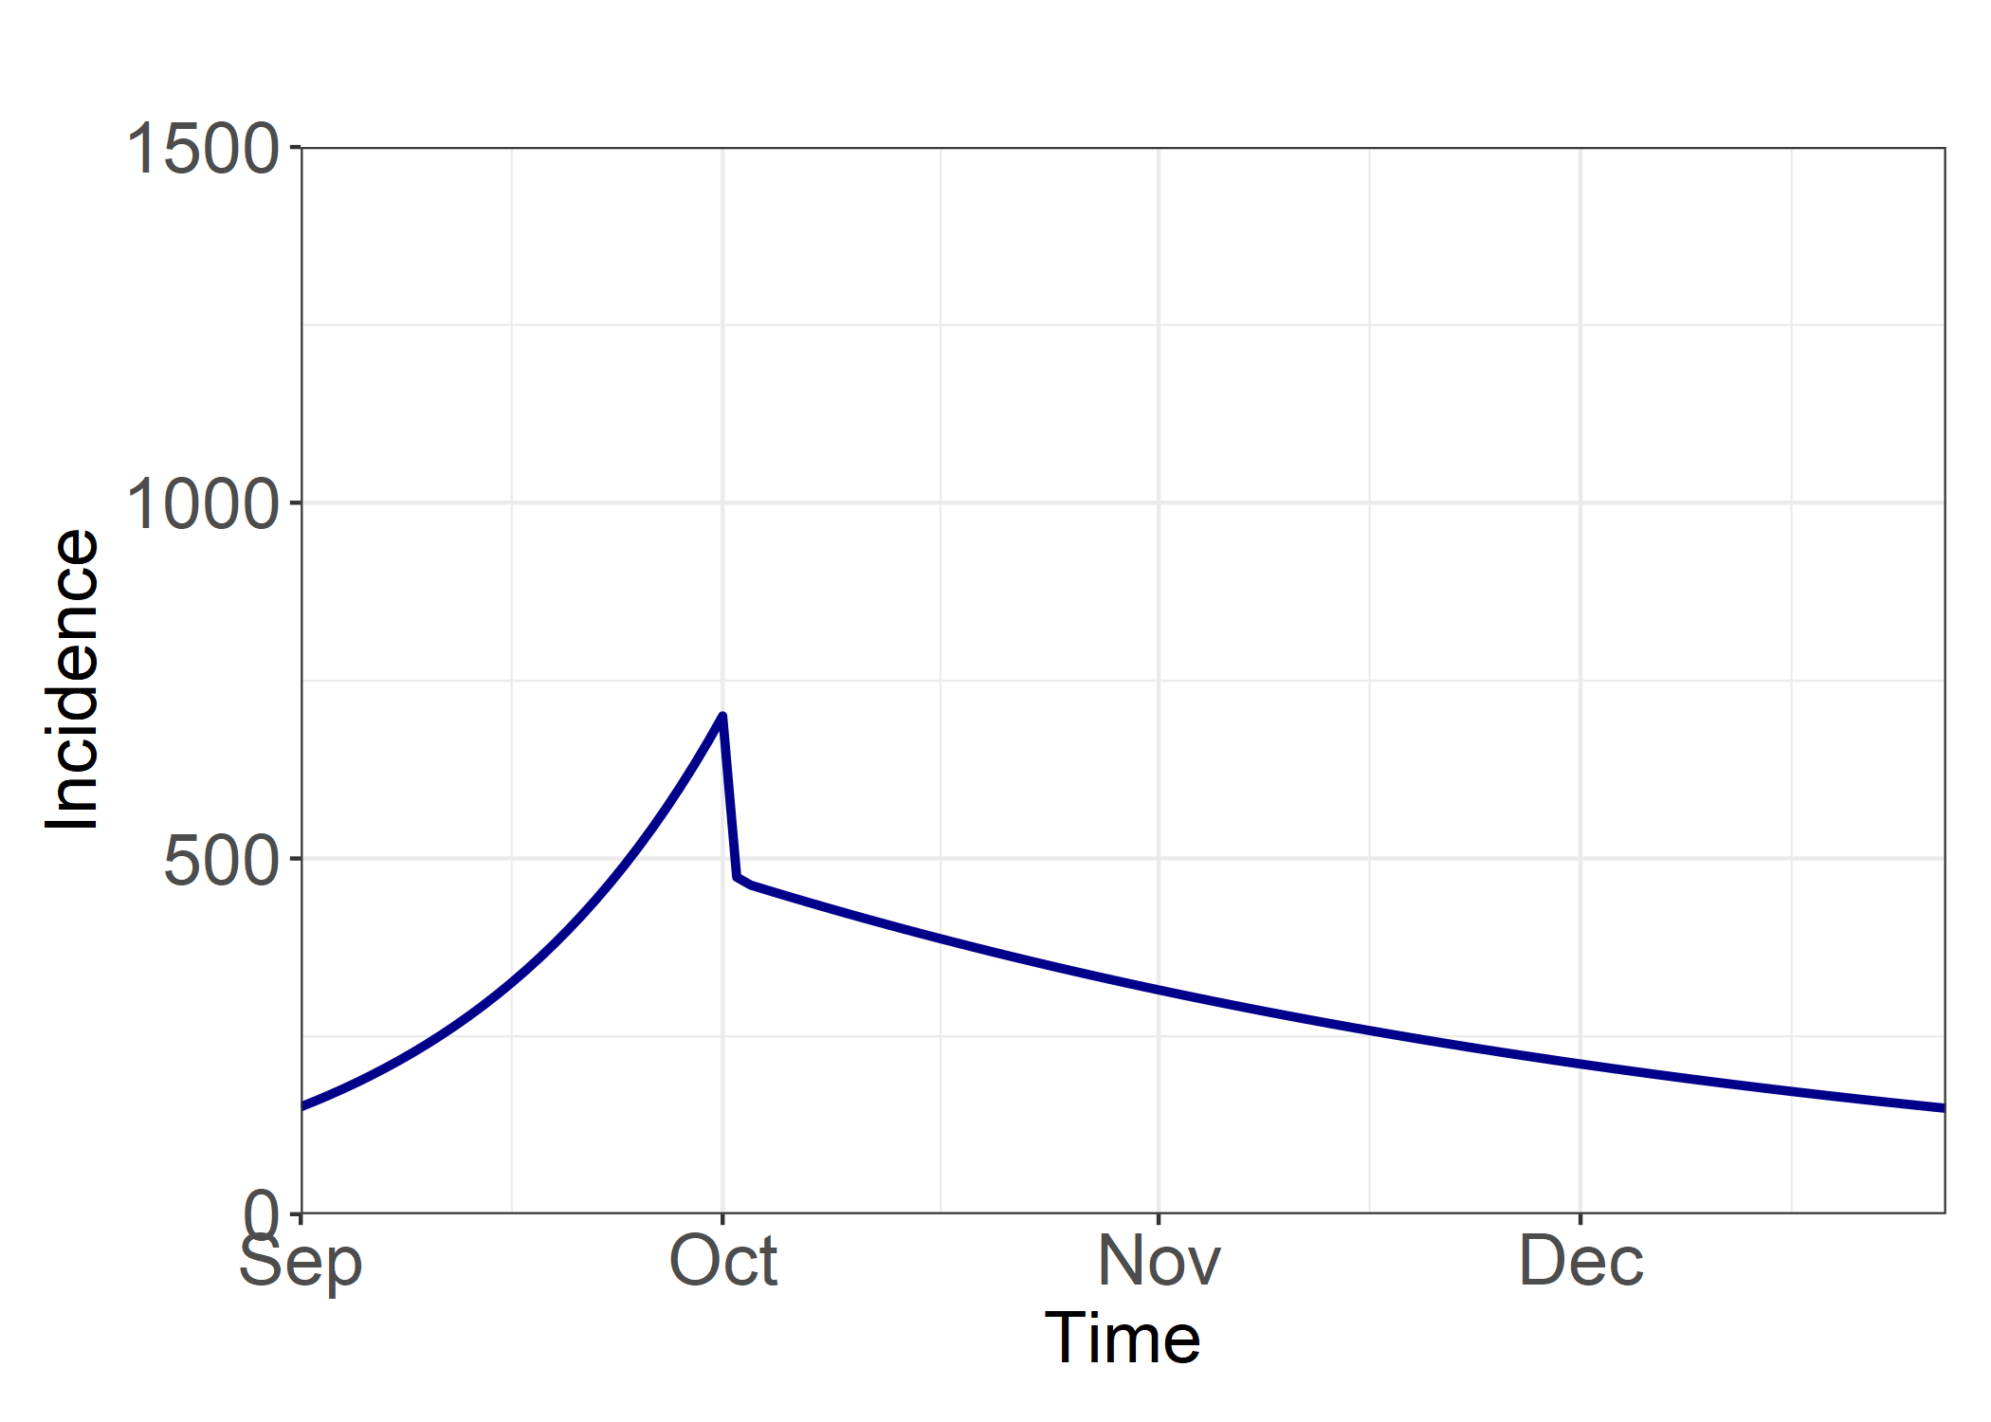
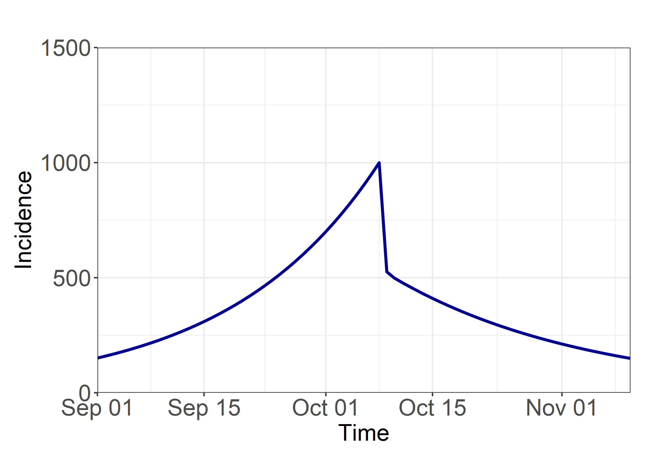
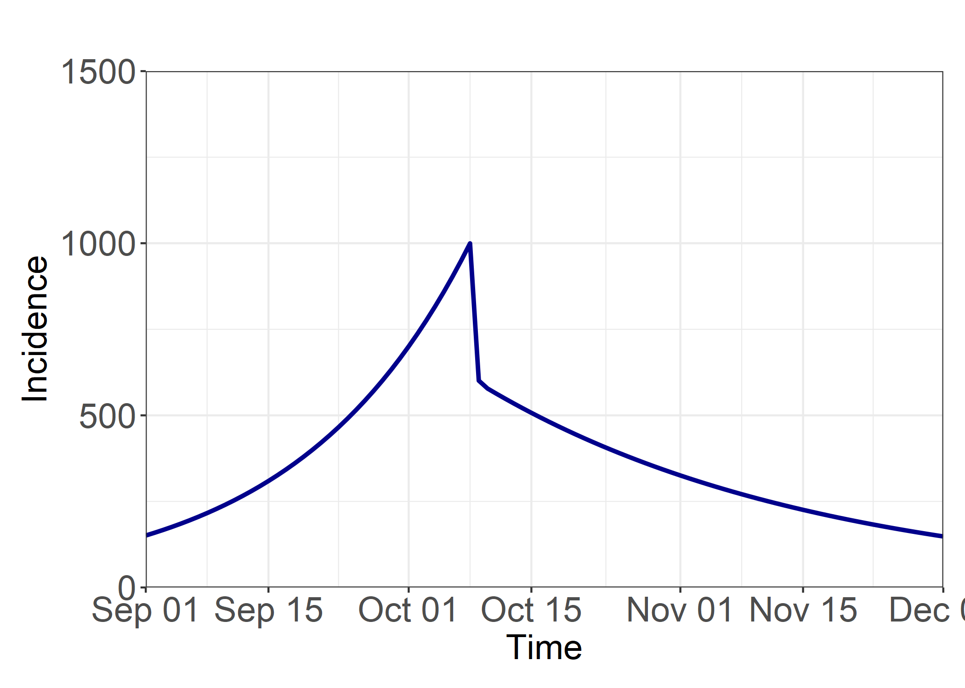
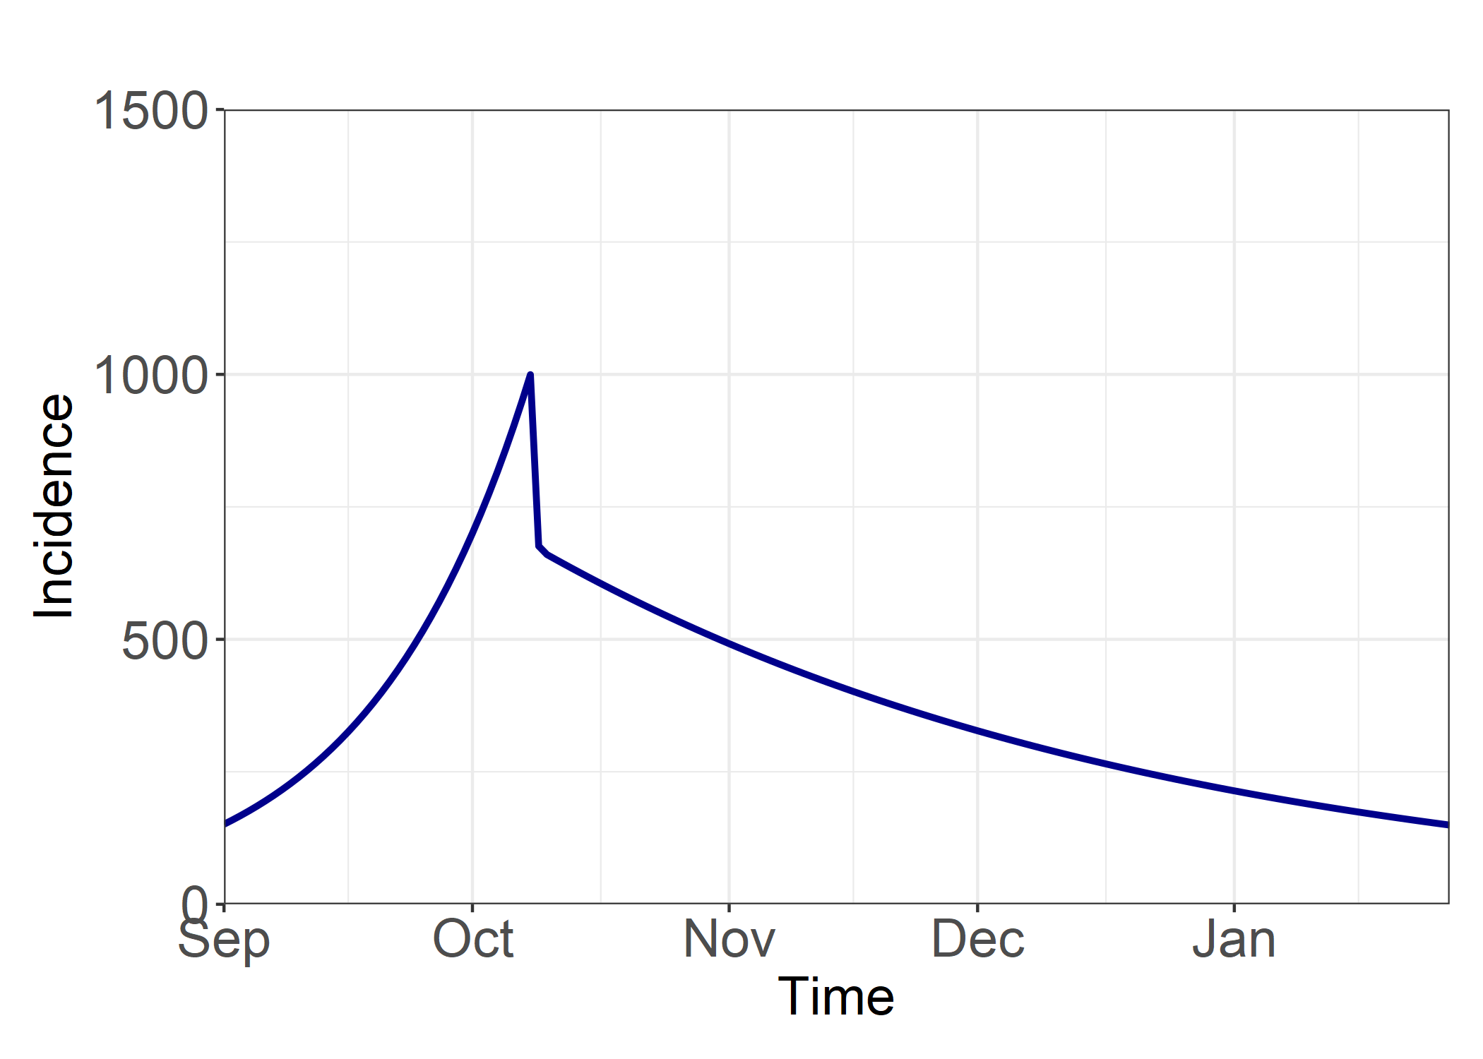
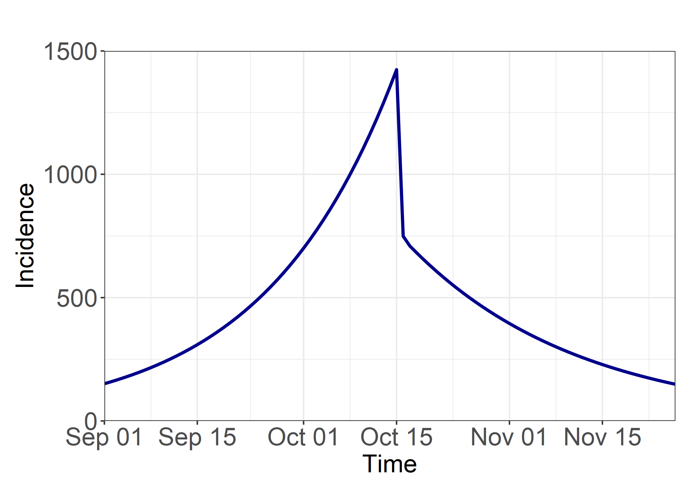
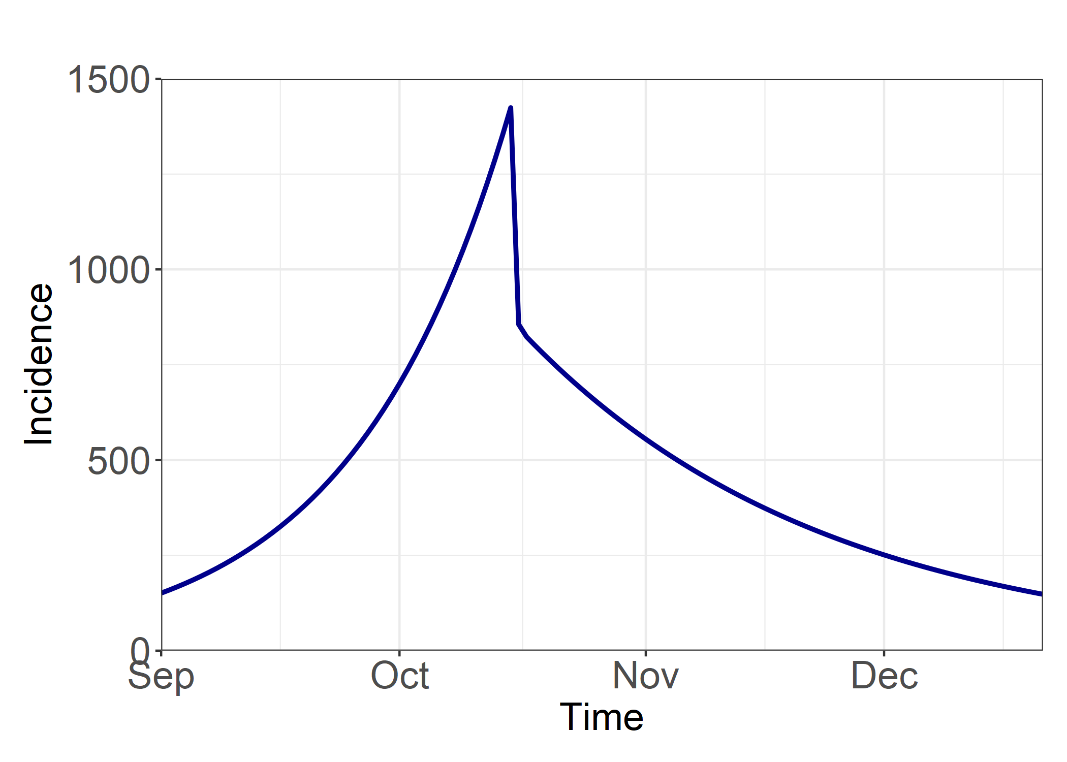
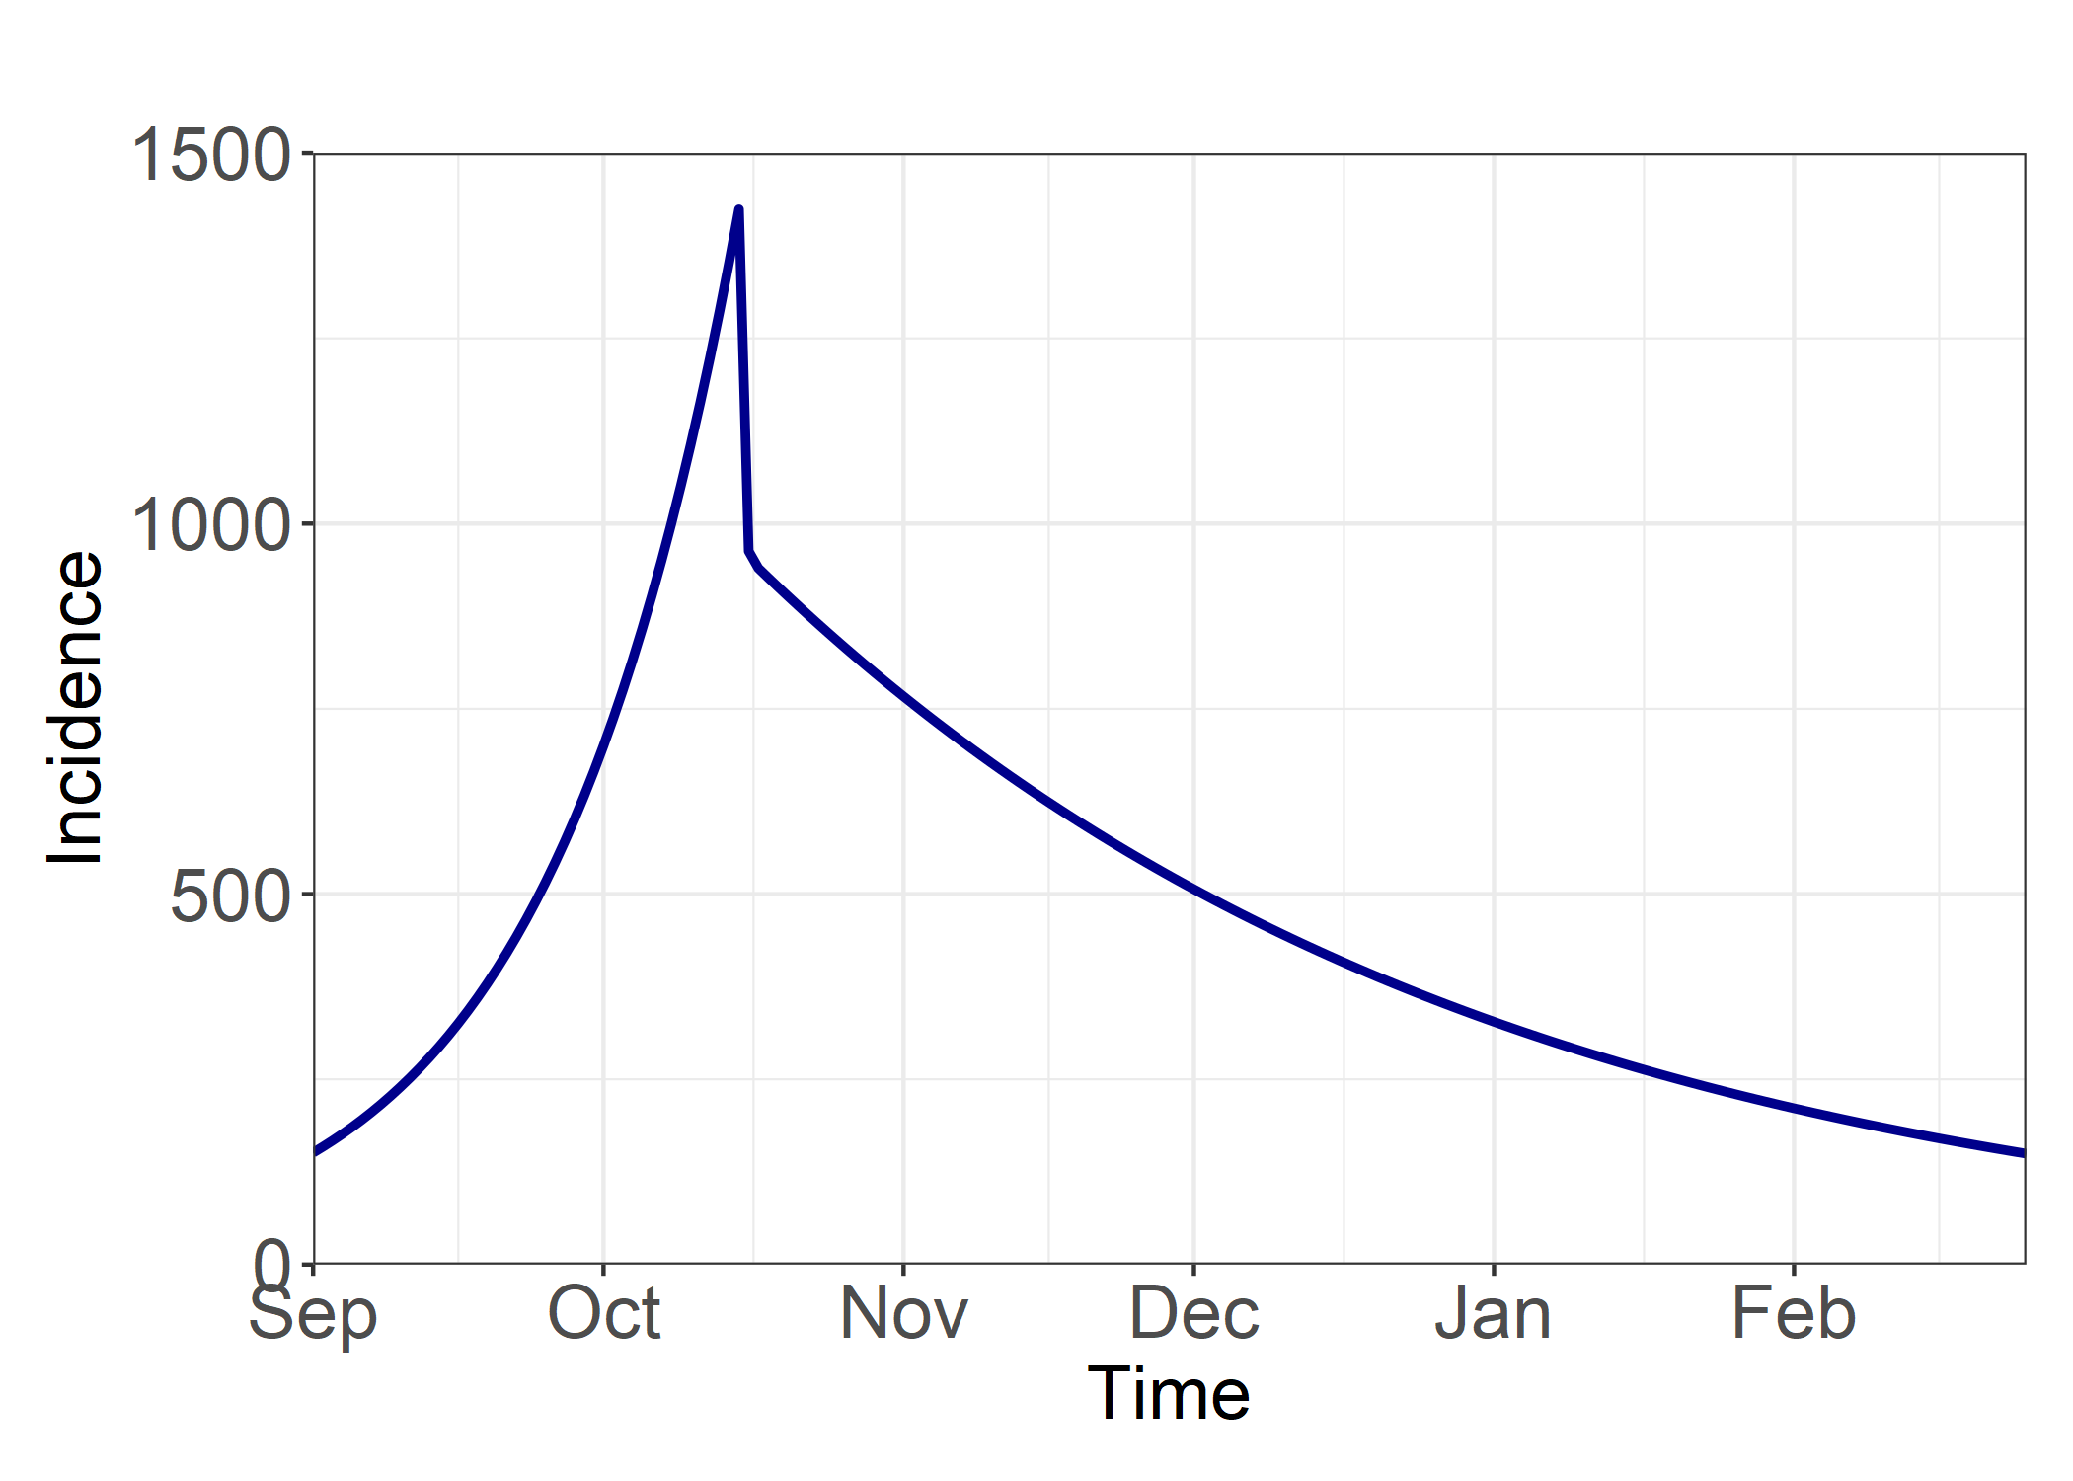
Post Intervention R = 0.7
Post Intervention R = 0.8
Post Intervention R = 0.9
Intervention Delay = 0 Days
A) Total Infections from 01/09/20 = 16963
B) Total Infections from 01/10/20 = 5787
B/A = 0.34
A) Total Infections from 01/09/20 = 21806
B) Total Infections from 01/10/20 = 10628
B/A = 0.49
A) Total Infections from 01/09/20 = 35527
B) Total Infections from 01/10/20 = 24351
B/A = 0.69
Intervention Delay = 7 Days
A) Total Infections from 01/09/20 = 27041
B) Total Infections from 01/10/20 = 15865
B/A = 0.59
A) Total Infections from 01/09/20 = 34613
B) Total Infections from 01/10/20 = 23436
B/A = 0.68
A) Total Infections from 01/09/20 = 55950
B) Total Infections from 01/10/20 = 44774
B/A = 0.80
Intervention Delay = 14 Days
A) Total Infections from 01/09/20 = 41367
B) Total Infections from 01/10/20 = 30190
B/A = 0.73
A) Total Infections from 01/09/20 = 52768
B) Total Infections from 01/10/20 = 41592
B/A = 0.79
A) Total Infections from 01/09/20 = 84174
B) Total Infections from 01/10/20 = 72998
B/A = 0.87

Slide 3
Methodology
Outcome Measures
Cumulative incidence from the beginning of simulation (01/09/20) until incidence goes back to 150 cases/day.
Cumulative incidence from 01/10/20 until incidence goes back to 150 cases/day.
Ratio of B/A
Sensitivity Analysis
We explore a delay to the intervention of 0/7/14 days.
Post-intervention β is defined using R = 0.9/0.8/0.7.
Model structure – Standard SIR model
Initial Conditions
S = 6,664,160
I = 840
R = 0
Parameter Values
β = 0.1797 (Using R = 1.4)
γ = 0.1284 (calculated using R₀ = 2.8 and a doubling time of 3 days)
Parameter values and initial conditions chosen so that:
At the start of the model simulation (t = 0) set at 01/09/20 the incidence is 150 cases.
At 01/10/20 (t = 30) the incidence is 700 cases
At baseline, the model Intervention is triggered the day after 1st October (t = 31).

